Slide 1

Working with Audio Part 1 Text-to-Speech

Slide 2
What We Will Cover
Understanding Audio
Text-to-Speech Overview
Creating Audio Files
TTS without Streaming
Chat Completions
Assistants
TTS with Streaming
Chat Completions
Assistants

Slide 3
Understanding Audio

Slide 4


A Tale of Two Models
Whisper
(Speech-to-Text)
TTS
(Text-to-Speech)

Slide 5
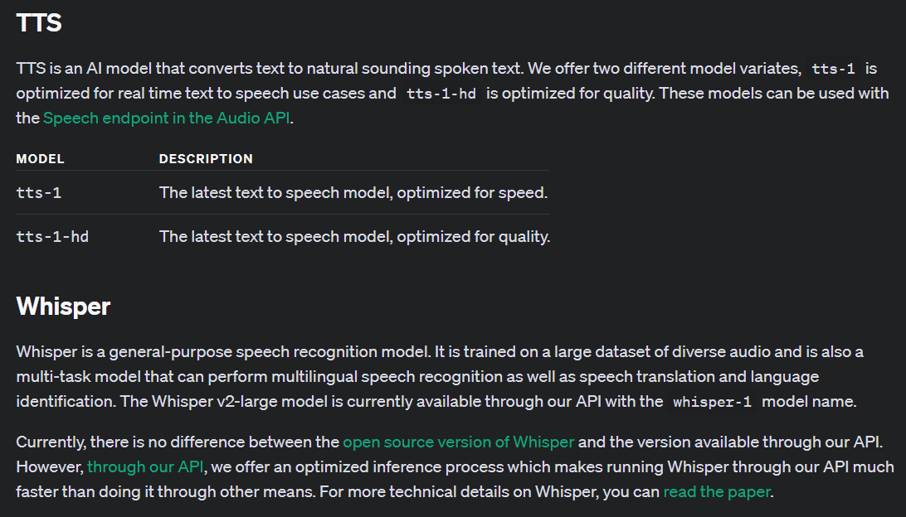
Notes:
https://platform.openai.com/docs/models/tts

Slide 6



Notes:
https://www.youtube.com/channel/UC35ZpwldGw7ZJ5R-2sLijzw

Slide 7
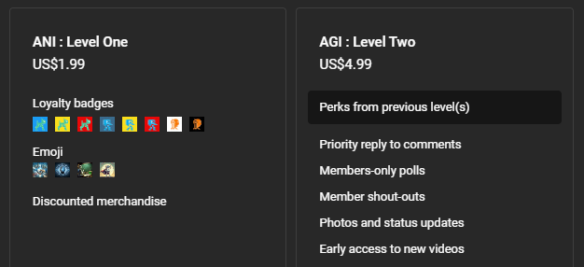

Membership has its privileges
Notes:
https://www.youtube.com/channel/UC35ZpwldGw7ZJ5R-2sLijzw/join

Slide 8

https://www.youtube.com/@AINewsFresh

Slide 9
TTS (Text-to-Speech)

Slide 10
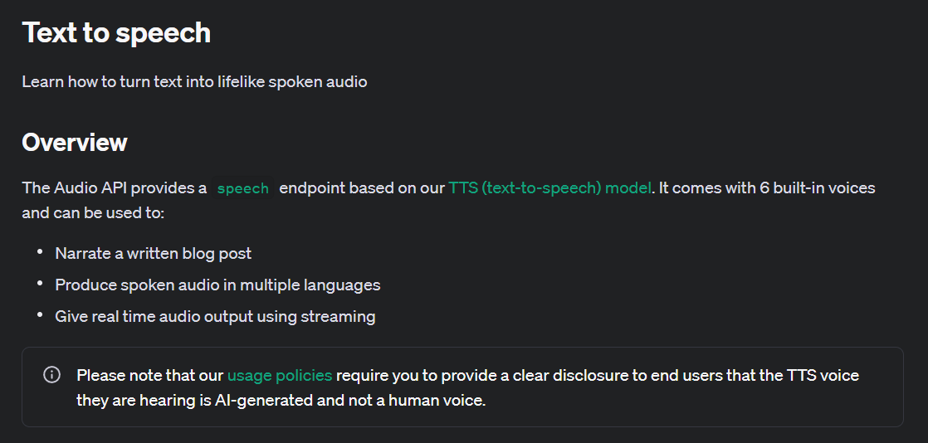
Notes:
https://platform.openai.com/docs/guides/text-to-speech/overview

Slide 11
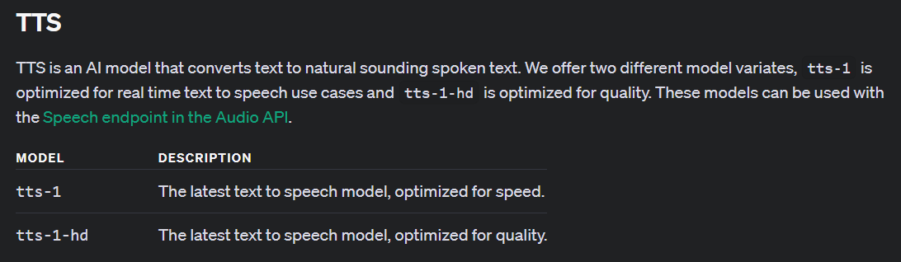
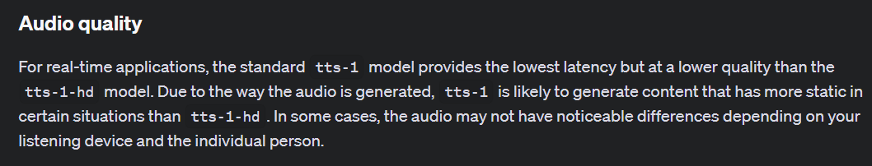
Notes:
https://platform.openai.com/docs/models/tts
https://platform.openai.com/docs/guides/text-to-speech/audio-quality

Slide 12
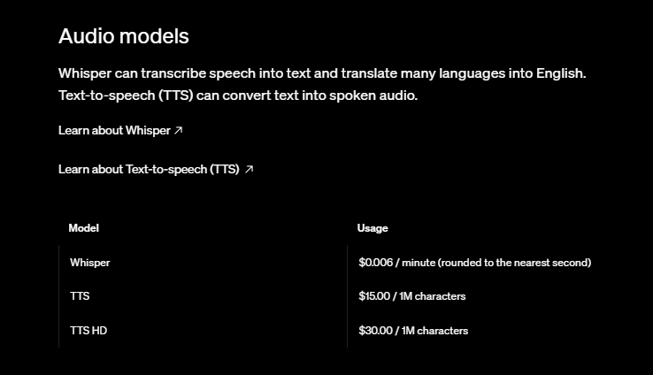
Notes:
https://openai.com/api/pricing/

Slide 13
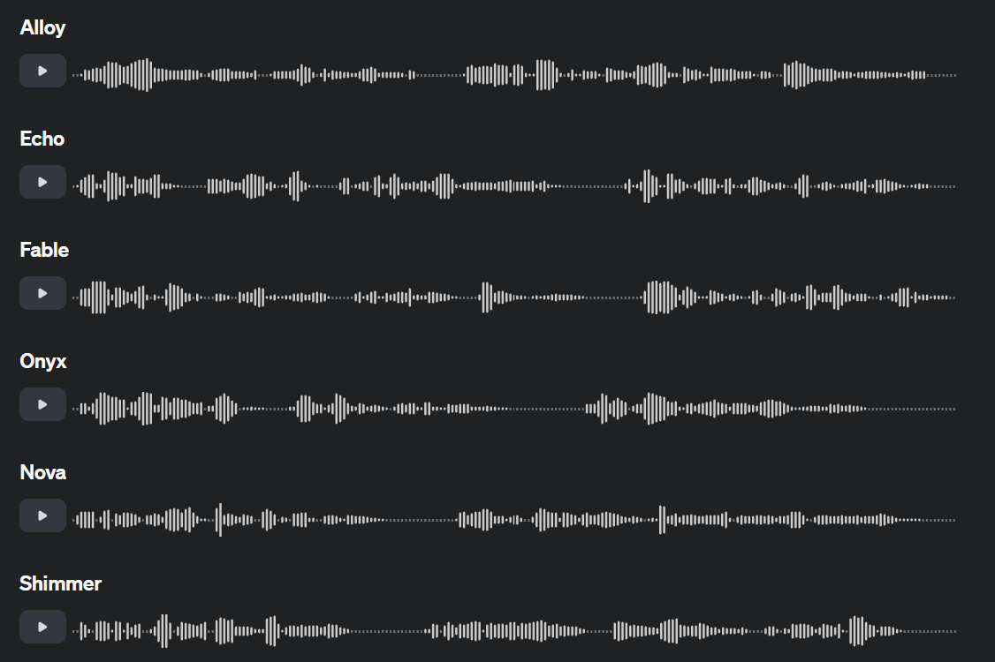
Notes:
https://platform.openai.com/docs/guides/text-to-speech/voice-options

Slide 14
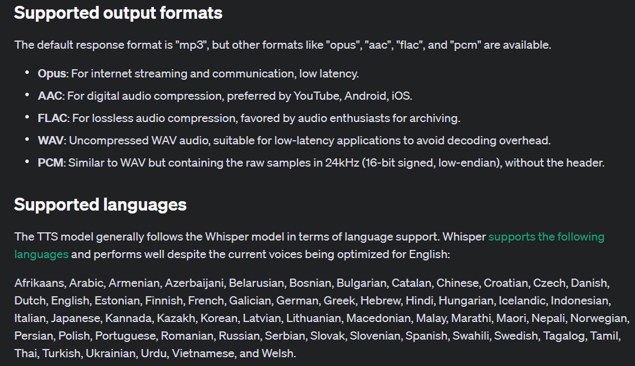
Notes:
https://platform.openai.com/docs/guides/text-to-speech/supported-output-formats

Slide 15
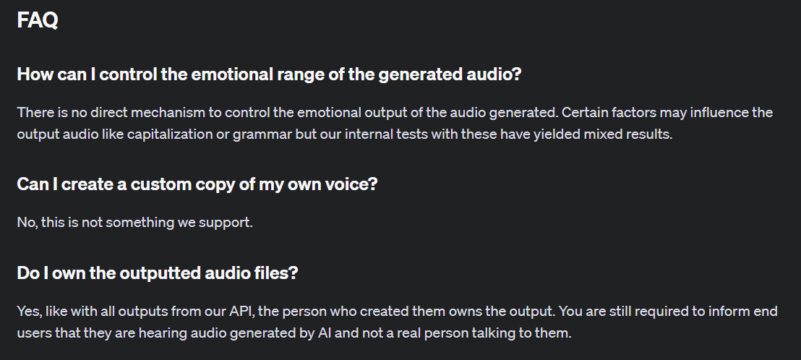
Notes:
https://platform.openai.com/docs/guides/text-to-speech/faq

Slide 16
Demo: Generating an Audio File
# Define the speech file path
speech_file_path = "./some_audio.mp3"
# Create the TTS (Text-to-Speech) request
response = client.audio.speech.create(
model="tts-1-hd", # Specify the TTS model to use
voice="fable", # Specify the voice to use for the TTS
input="""
This is some text to be converted to audio.
""" # Input text to be converted to speech
)
# Save the response audio to a file
with open(speech_file_path, 'wb') as file:
file.write(response.content) # Write the audio content to the file
# Print a message indicating where the audio was saved
print(f"Audio saved to {speech_file_path}")

Slide 17
TTS with Chat Completions and Assistants

Slide 18
Feeding Generated Output to TTS
Chat Completion
Or
Assistant
TTS
(Text-to-Speech)

Slide 19
Demo: Chat Completion and Assistant Output to TTXS
if response.status_code == 200:
buffer = BytesIO()
# Save audio chunks to file and buffer
with open(speech_file_path, 'wb') as file:
for chunk in response.iter_content(chunk_size=1024):
if chunk:
file.write(chunk)
buffer.write(chunk)
buffer.seek(0)
# Read and play the audio from the buffer
data, samplerate = sf.read(buffer)
sd.play(data, samplerate)
sd.wait() # Wait until the audio playback is done

Slide 20
Streaming Output

Slide 21
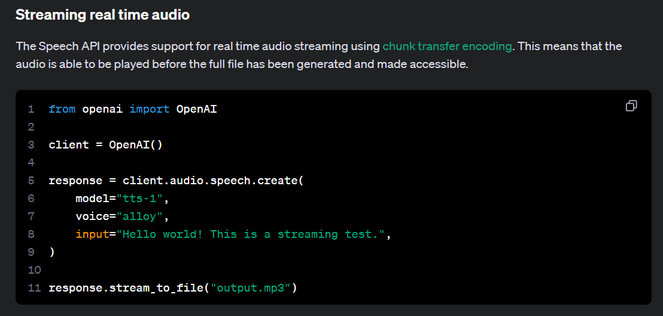

Notes:
https://platform.openai.com/docs/guides/text-to-speech/streaming-real-time-audio

Slide 22
Demo: Creating a File and Streaming
# Define the speech file path
speech_file_path = "./wonderfulday.mp3"
# Create the TTS (Text-to-Speech) request using the recommended method
with client.audio.speech.with_streaming_response.create(
model="tts-1",
voice="alloy",
input="Today is a wonderful day to build something people love!"
) as response:
with open(speech_file_path, 'wb') as f:
for chunk in response.iter_bytes():
f.write(chunk)
# Print a message indicating where the audio was saved
print(f"Audio saved to {speech_file_path}")

Slide 23
Demo: Streaming TTS with Chat Completions and Assistants
# Initialize PyAudio
p = pyaudio.PyAudio()
# Open a stream with specific audio format parameters
stream = p.open(format=pyaudio.paInt16,
channels=1,
rate=24000,
output=True)

Slide 24
